Slide 1

CSE 464 : Software Quality Assurance and Testing
Exploratory Testing
Janaka Balasooriya

Slide 3
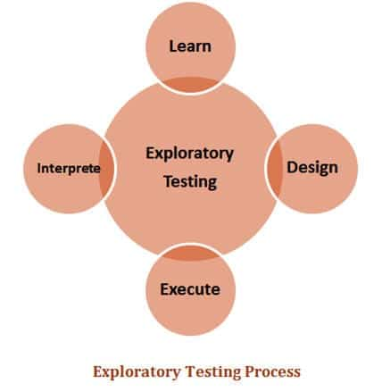
Exploratory Testing – Basic Principle
Learn as you go.
Focus on goals, not steps.
Adapt and explore.
Document findings effectively.
Collaborate and share insights.

Slide 4
Exploratory Testing - Approach
Understanding stakeholders including end users and their expectations
Learn the system
Think about what the system supposed to do. Also, check if its doing what it should not do
https://www.softwaretestinghelp.com/what-is-exploratory-testing/

Slide 5
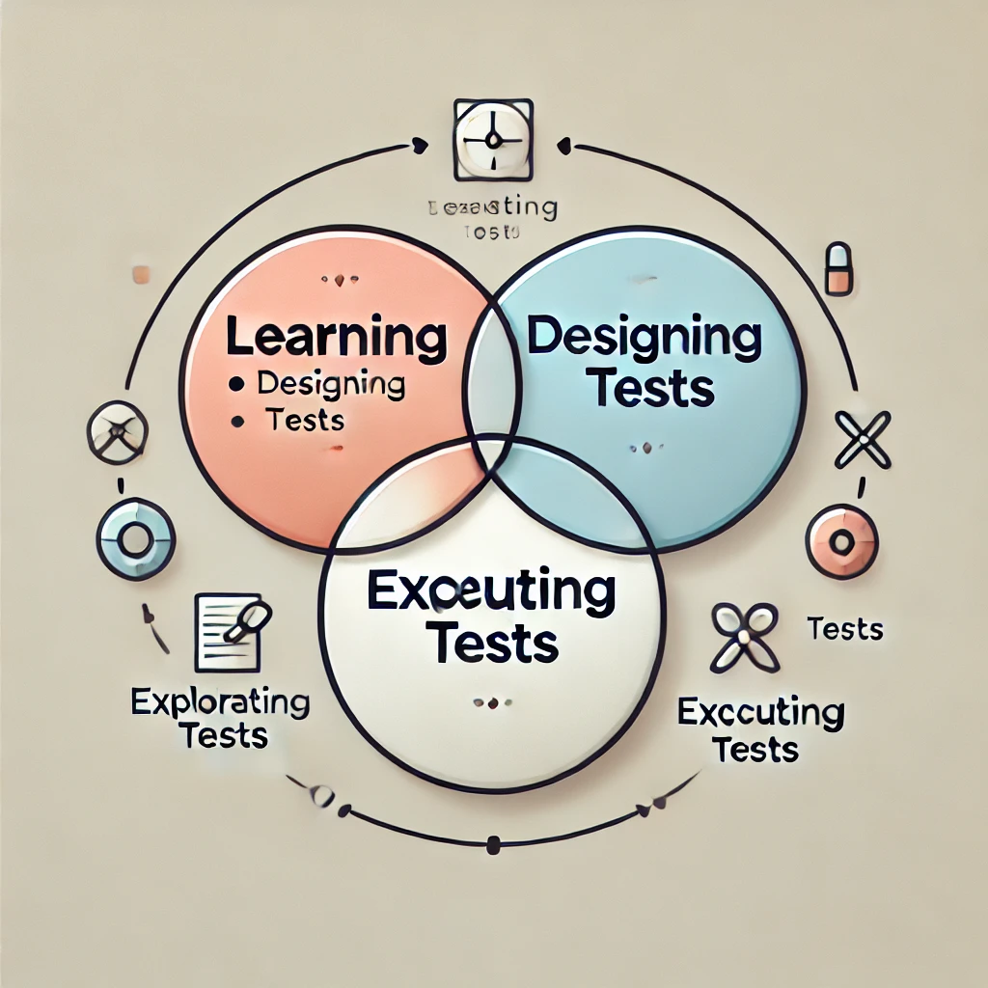
AI Explanation of Exploratory Testing
This is not the best explanation – AI is not trustworthy always !

Slide 6
Exploratory Testing – Approaches

Slide 7
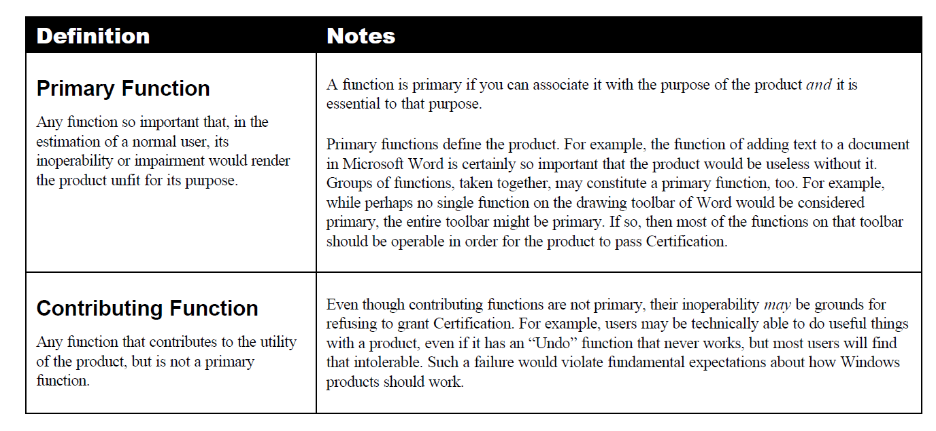
Exploratory Testing : Function Categorization Approach
http://www.satisfice.com/tools/procedure.pdf

Slide 8
Exploratory Testing – Other Approaches
Some Popular Heuristics for Exploratory Testing
  SFDIPOT: Structure, Function, Data, Interfaces, Platform, Operations, Time.
  CRISP: Consistency, Reliability, Interactions, Security, Performance
Heuristics helps
  Guide exploration.
  Uncover areas of risk

Slide 9
Function (F): Features and capabilities of the system (Core functionalities, Business Logic.
Structure (s): The physical and logical components of the system, including its architecture, design, and layout.
Data (D): Inputs, outputs, and data storage
Time (T): Time-related functionalities(Performance, response times, scheduling, date/time operations)
Interface (I): Communication points between components or external systems
SFDIPOT
Operations (O): Processes for operation and maintenance (Installation, configuration, monitoring, backups, updates)
Platform (P): The environment in which the system runs, including hardware, software, and networks.

Slide 10
SFDIPOT Example - Online Shopping Store
Testing an Online Shopping Store Using Exploratory Testing
Structure: Check the layout of the cart page. Are all products and prices displayed correctly?
Function: Test if adding/removing items updates totals.
Data: Use edge cases (e.g., 1,000 items or special characters in item names).
Interfaces: Verify if APIs correctly fetch cart details and calculate totals.
Platform: Test the cart on mobile, desktop, and across browsers.
Operations: Check cart persistence after logging out and back in.
Time: Verify scheduled discounts (e.g., holiday sales) and how expiration times affect the cart, time based performance parameters like response time

Slide 11
Tool Support for Exploratory Testing
Microsoft Azure Test Plans
https://docs.microsoft.com/en-us/azure/devops/test/overview?view=azure-devops#manual-testing-in-test-manager
qTest explorer
https://www.qasymphony.com/software-testing-tools/qtest-explorer/test-execution-recorder/
Testpad
https://ontestpad.com/library/151/structure-example-exploratory-testing
HP Sprinter
https://www.microfocus.com/en-us/products/sprinter-manual-software-testing/overview
…. more

Slide 12
Exploratory Testing - Resources
Exploratory Testing Resources
What is exploratory testing - video by Cem Kaner
https://mediaplus.asu.edu/embedded?id=80e96701-fbb8-4222-9a07-8a170cc3ef26&siteId=61e0606e-415d-4001-8206-ffde48430c64
What is exploratory testing - document
http://www.satisfice.com/tools/procedure.pdf
Performing Exploratory Testing- Microsoft
https://docs.microsoft.com/en-us/azure/devops/test/insights-exploratory-testing?view=azure-devops

Slide 13
Writing Test Cases : Anatomy of a Typical Test Case
IEEE Standard 610 (1990) defines test case as follows:
“(1) A set of test inputs, execution conditions, and expected results developed for a
particular objective, such as to exercise a particular program path or to verify compliance
with a specific requirement.
“(2) (IEEE Std 829-1983) Documentation specifying inputs, predicted results, and a set
of execution conditions for a test item.”
Test case ID
Purpose
Preconditions
Inputs
Expected outputs
Post conditions
Execution History
Date Result Version Run By
http://www.kaner.com/pdfs/GoodTest.pdf

Slide 14
Characteristics of a Good Test Engineer : 10 Engineering Competences
Analytical Problem Solving
Customer- focused Innovation
Technical excellence
Project/Time Management
Passion for quality
Strategic insight
Confidence
Impact and Influence
Cross-Boundary Collaboration
Interpersonal Awareness
Reference : How We Test Software at Microsoft by Alan Page , Ken Johnston , Bj Rollison

Slide 15
Next Time : More About Functional Testing

